Slide 1

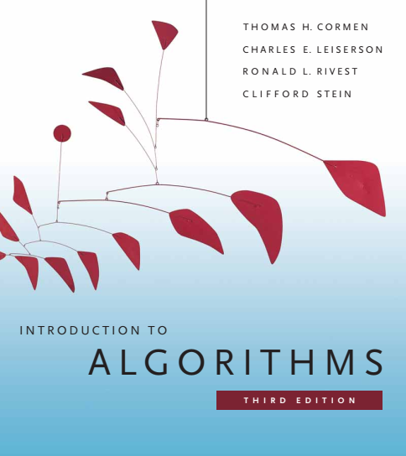
Design and Analysis of Algorithms
Dr. Sajid Iqbal
sajidiqbal.pk@gmail.com
Reference Book
Introduction to Algorithms 3rd Edition By Thomas H. Cormen et. al.
https://mitpress.mit.edu/books/introduction-algorithms-third-edition
COMEDXD

Slide 2
Strassen’s Method for Matrix Multiplication
An application of divide and conquer Technique

Slide 3
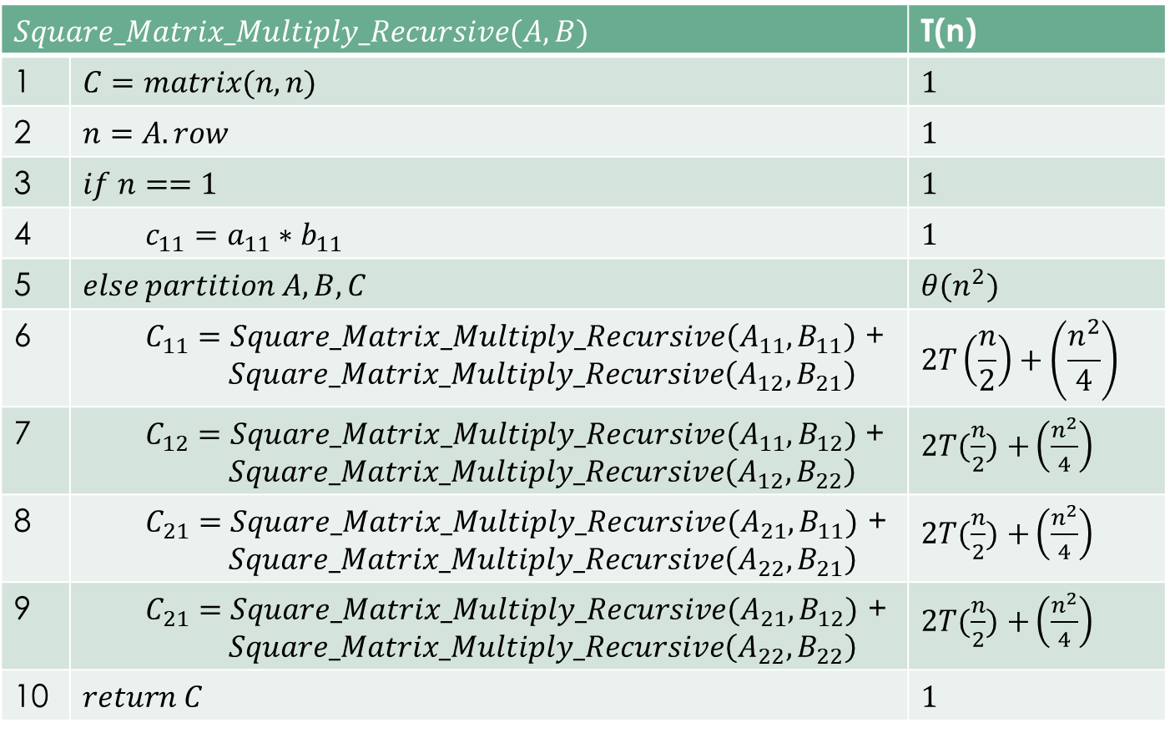
Time Complexity of Recursive Matrices Multiplication
$$Square_Matrix_Multiply_Recursive(A,B)$$ |  | T(n)
1 | $$C=matrix(n,n)$$ | $$1$$
2 | $$n=A.row$$ | $$1$$
3 | $$if n==1$$ | $$1$$
4 | $$c_{11}=a_{11}∗b_{11}$$ | $$1$$
5 | $$else partition A,B,C$$ | $$θ(n^{2})$$
6 | $C_{11}=Square_Matrix_Multiply_Recursive\left(A_{11},B_{11}\right)$ + $$Square_Matrix_Multiply_Recursive\left(A_{12},B_{21}\right)$$ | $$2T\left(\frac{n}{2}\right)+\left(\frac{n^{2}}{4}\right)$$
7 | $C_{12}=Square_Matrix_Multiply_Recursive(A_{11},B_{12})$ + $$Square_Matrix_Multiply_Recursive\left(A_{12},B_{22}\right)$$ | $2T(\frac{n}{2})$ $+\left(\frac{n^{2}}{4}\right)$
8 | $$C_{21}=Square_Matrix_Multiply_Recursive(A_{21},B_{11})\text{ +}$$ $$Square_Matrix_Multiply_Recursive\left(A_{22},B_{21}\right)$$ | $2T(\frac{n}{2})$ $+\left(\frac{n^{2}}{4}\right)$
9 | $$C_{21}=Square_Matrix_Multiply_Recursive(A_{21},B_{12})\text{ +}$$ $$Square_Matrix_Multiply_Recursive\left(A_{22},B_{22}\right)$$ | $2T(\frac{n}{2})$ $+\left(\frac{n^{2}}{4}\right)$
10 | $$return C$$ | $$1$$
8 recursive calls

Slide 4

Strassen Algorithm
Strassen’s method is little improvement over our recursive method
Instead of 8 recursive calls of multiplications, this method uses on 7
It has four steps:
Divide the matrices A,B,C into four parts each totaling 12 each of size $\frac{n}{2}$
Create 10 matrices $S_{1},S_{2},….,S_{10}$. Each of which is size $\frac{n}{2}$. Each of these is sum or difference of two matrices which are created in first step.
These matrices can be created in $θ(n^{2})$ time

Slide 5

Strassen Algorithm
Using the submatrices created in step 1 and the 10 matrices created in step 2, recursively compute seven matrix products $P_{1},P_{2},….,P_{7}$. Each of these will be of size $\frac{n}{2}$
Compute the desired sub-matrices $C_{11},C_{12},C_{21},C_{22}$ by adding and subtracting different combinations of Pi matrices.
We can compute all matrices in $θ(n^{2})$ time

Slide 6
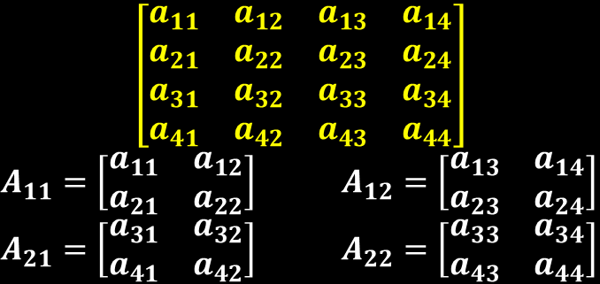

Step 1- Strassen Algorithm
Partition the matrices A,B,C into four parts each totaling 12 each of size $\frac{n}{2}$
It takes $θ\left(n^{2}\right)$ as described in previous lecture
we can make this step faster using array method as follows
$A_{11}=A\left[1:\frac{n}{2},1:\frac{n}{2}\right], A_{12}=\left[1:\frac{n}{2},\frac{n+1}{2}:n\right] A_{21}=\left[\frac{n+1}{2}:n,1:\frac{n}{2}\right] A_{22}=[\frac{n+1}{2}:n,\frac{n+1}{2}:n]$
This method takes constant time i.e. $θ(1)$ instead of $θ(n^{2})$

Slide 7
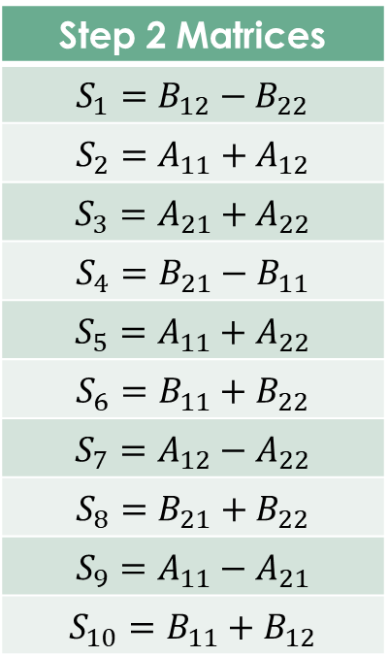

Step 2- Strassen Algorithm
Step 2 Matrices
$$S_{1}=B_{12}−B_{22}$$
$$S_{2}=A_{11}+A_{12}$$
$$S_{3}=A_{21}+A_{22}$$
$$S_{4}=B_{21}−B_{11}$$
$$S_{5}=A_{11}+A_{22}$$
$$S_{6}=B_{11}+B_{22}$$
$$S_{7}=A_{12}−A_{22}$$
$$S_{8}=B_{21}+B_{22}$$
$$S_{9}=A_{11}−A_{21}$$
$$S_{10}=B_{11}+B_{12}$$
Create the following 10 matrices:
This step takes $θ(n^{2})$ time
To add two matrices, we can write following algorithm
$for i=1 to n$
$for j=1 to n$
$c\left(I,j\right)=a\left(I,j\right)+b\left(I,j\right)$
This algorithm takes $θ(n^{2})$ time

Slide 8
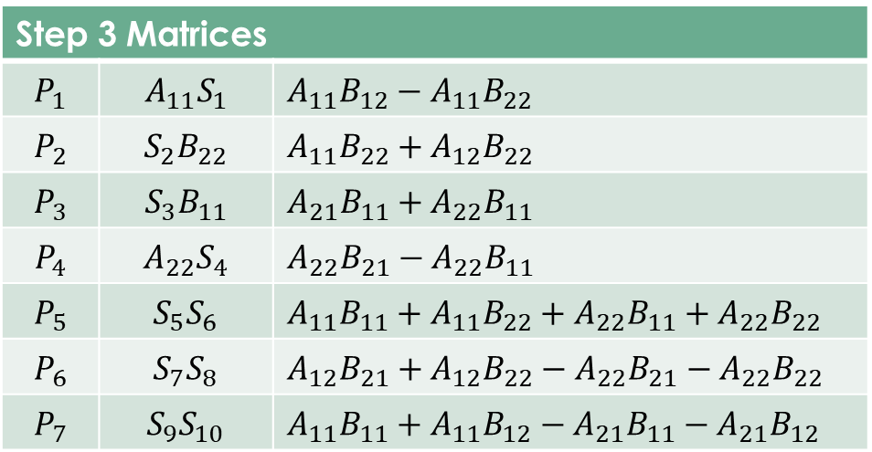

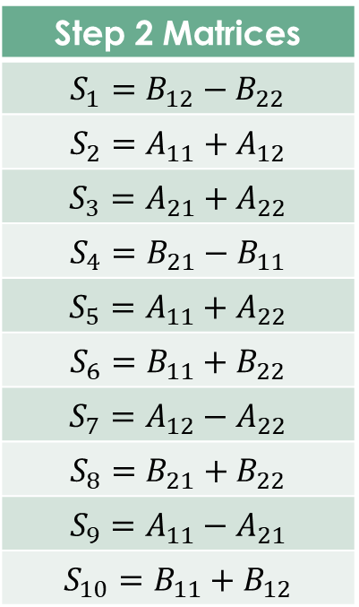
Step 3
Recursively multiply $\frac{n}{2}x\frac{n}{2}$ matrices seven times to compute the other $\frac{n}{2}x\frac{n}{2}$matrices, each of which is the sum or difference of products of A and B submatrices
In our recursive solution of matrix multiplication, we did 8 recursions
Its time complexity was ${θ(n}^{log8})=θ(n^{3} )$
Step 3 performs 7 steps so
its time complexity is ${θ(n}^{log7})=θ(n^{2.8} )$
Step 2 Matrices
$$S_{1}=B_{12}−B_{22}$$
$$S_{2}=A_{11}+A_{12}$$
$$S_{3}=A_{21}+A_{22}$$
$$S_{4}=B_{21}−B_{11}$$
$$S_{5}=A_{11}+A_{22}$$
$$S_{6}=B_{11}+B_{22}$$
$$S_{7}=A_{12}−A_{22}$$
$$S_{8}=B_{21}+B_{22}$$
$$S_{9}=A_{11}−A_{21}$$
$$S_{10}=B_{11}+B_{12}$$

Slide 9

$A= \left[\begin{matrix}a_{11} & a_{12} \\ a_{21} & a_{22}\end{matrix}\right]$ and $B=$ $\left[\begin{matrix}b_{11} & b_{12} \\ b_{21} & b_{22}\end{matrix}\right]$
$A∗B=\left[\begin{matrix}a_{11} & a_{12} \\ a_{21} & a_{22}\end{matrix}\right]\left[\begin{matrix}b_{11} & b_{12} \\ b_{21} & b_{22}\end{matrix}\right]$
$C=AB=\left[\begin{matrix}a_{11}b_{11}+a_{12}b_{21} & a_{11}b_{12}+a_{12}b_{22} \\ a_{21}b_{11}+a_{22}b_{21} & a_{21}b_{12}+a_{22}b_{22}\end{matrix}\right]=\left[\begin{matrix}C_{11} & C_{12} \\ C_{21} & C_{22}\end{matrix}\right]$
$C_{11}=A_{11}B_{11}+A_{12}B_{21}$
$C_{12}=A_{11}B_{12}+A_{12}B_{22}$
$C_{21}=A_{21}B_{11}+A_{22}B_{21}$
$C_{22}=A_{21}B_{12}+A_{22}B_{22}$

Slide 10
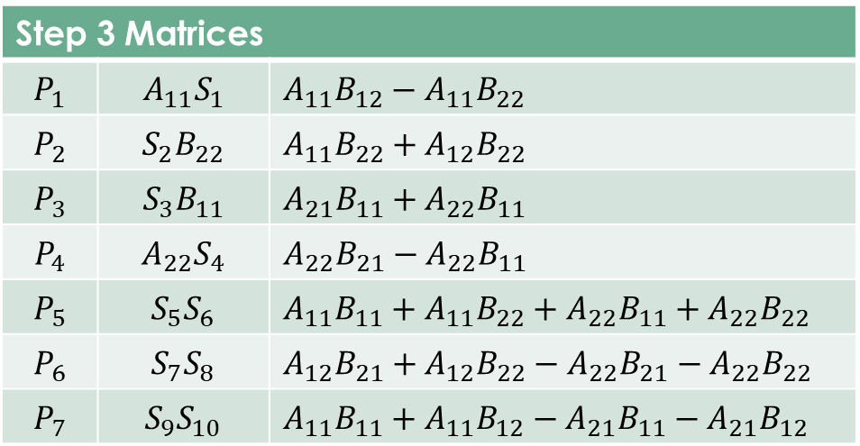
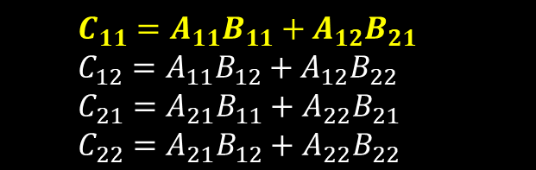

Step 4 – Strassen Algorithm
Add and subtract the $P_{i}$ matrices created in step 3 to construct the four $\frac{n}{2}x\frac{n}{2}$ submatrices of the product C
$C_{11}=P_{5}+P_{4}−P_{2}+P_{6}$
Now substitute $P_{i}s$ with actual matrices
($A_{11}B_{11}+A_{11}B_{22}+A_{22}B_{11}+A_{22}B_{22}$)+$(A_{22}B_{21}−A_{22}B_{11}$) –
$(A_{11}B_{22}+A_{12}B_{22}$)+($A_{12}B_{21}+A_{12}B_{22}−A_{22}B_{21}−A_{22}B_{22}$)
$A_{11}B_{11}+A_{11}B_{22}+A_{22}B_{11}+A_{22}B_{22}$+$A_{22}B_{21}−A_{22}B_{11}$ –
$A_{11}B_{22}−A_{12}B_{22}$+$A_{12}B_{21}+A_{12}B_{22}−A_{22}B_{21}−A_{22}B_{22}$
$A_{11}B_{11}$+ $A_{12}B_{21}=C_{11}$
$C_{11}{=A}_{11}B_{11}$+ $A_{12}B_{21}$
$$C_{11}=A_{11}B_{11}+A_{12}B_{21}$$
$$C_{12}=A_{11}B_{12}+A_{12}B_{22}$$
$$C_{21}=A_{21}B_{11}+A_{22}B_{21}$$
$$C_{22}=A_{21}B_{12}+A_{22}B_{22}$$

Slide 11
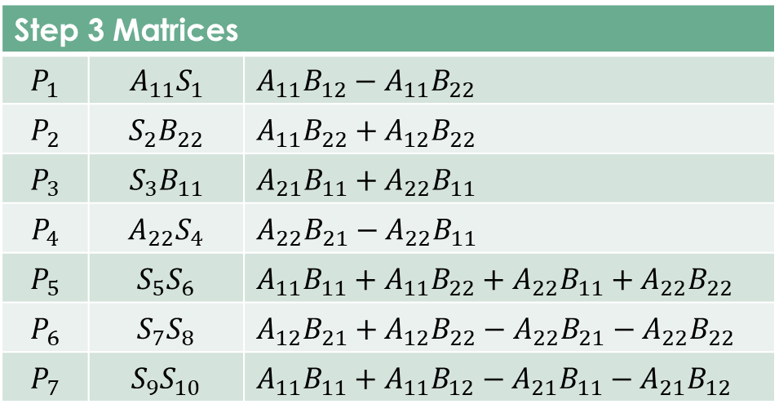
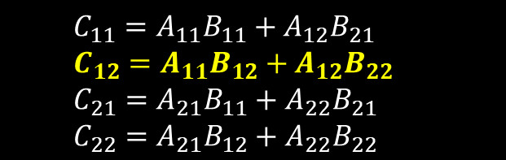

Step 4 – Strassen Algorithm
$C_{12}=P_{1}+P_{2}$
$C_{12}=$ ($A_{11}B_{12}−A_{11}B_{22})+(A_{11}B_{22}+A_{12}B_{22})$
$C_{12}=$ $A_{11}B_{12}+A_{12}B_{22}$
$$C_{11}=A_{11}B_{11}+A_{12}B_{21}$$
$$C_{12}=A_{11}B_{12}+A_{12}B_{22}$$
$$C_{21}=A_{21}B_{11}+A_{22}B_{21}$$
$$C_{22}=A_{21}B_{12}+A_{22}B_{22}$$

Slide 12
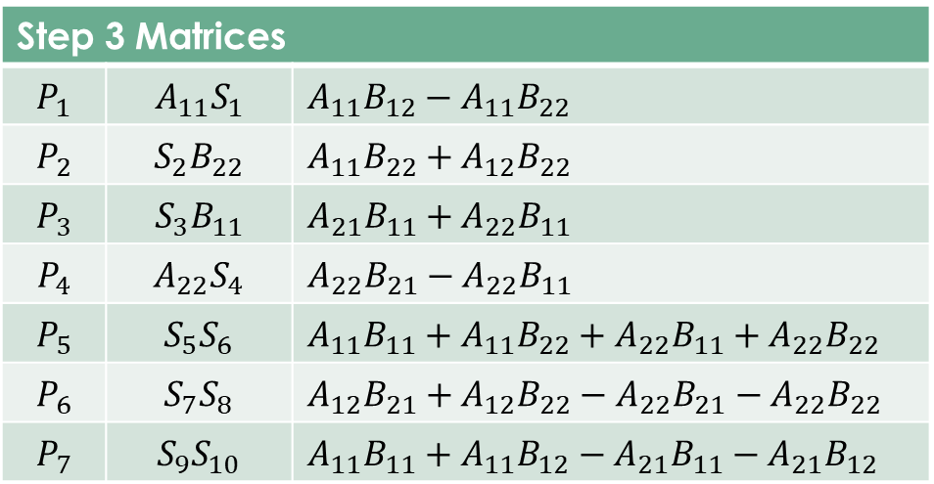

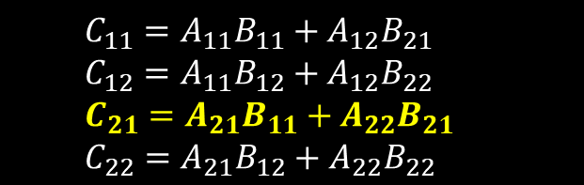
Step 4 – Strassen Algorithm
$C_{21}=P_{3}+P_{4}$
$C_{21}=\left(A_{21}B_{11}+A_{22}B_{11}\right)+(A_{22}B_{21}−A_{22}B_{11})$
$C_{21}=A_{21}B_{11}+A_{22}B_{21}$
$$C_{11}=A_{11}B_{11}+A_{12}B_{21}$$
$$C_{12}=A_{11}B_{12}+A_{12}B_{22}$$
$$C_{21}=A_{21}B_{11}+A_{22}B_{21}$$
$$C_{22}=A_{21}B_{12}+A_{22}B_{22}$$

Slide 13

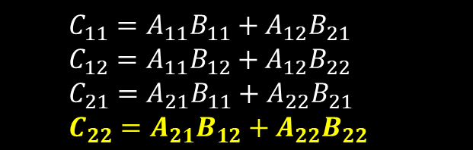

Step 4 – Strassen Algorithm
$C_{22}=P_{5}+P_{1}−P_{3}−P_{7}$
$C_{22}=$($A_{11}B_{11}+A_{11}B_{22}+A_{22}B_{11}+A_{22}B_{22}$)+($A_{11}B_{12}−A_{11}B_{22}$)-($A_{21}B_{11}+A_{22}B_{11}$)- ($A_{11}B_{11}+A_{11}B_{12}−A_{21}B_{11}−A_{21}B_{12}$)
$C_{22}=A_{11}B_{11}+A_{11}B_{22}+A_{22}B_{11}+A_{22}B_{22}$+$A_{11}B_{12}−A_{11}B_{22}$-$A_{21}B_{11}−A_{22}B_{11}$- $A_{11}B_{11}−A_{11}B_{12}+A_{21}B_{11}+A_{21}B_{12}$
$C_{22}=A_{22}B_{22}+A_{21}B_{12}$
Step 4 takes $θ(n^{2})$ time as it adds or subtracts the products
$$C_{11}=A_{11}B_{11}+A_{12}B_{21}$$
$$C_{12}=A_{11}B_{12}+A_{12}B_{22}$$
$$C_{21}=A_{21}B_{11}+A_{22}B_{21}$$
$$C_{22}=A_{21}B_{12}+A_{22}B_{22}$$

Slide 14

Time Complexity of Strassen Algorithm
Step 1= $θ(n^{2})$ Step 2= $θ(n^{2})$ Step 3= ${θ(n}^{log7})=θ(n^{2.8} )$ Step 4= $θ(n^{2})$
$T(n)=θ(n^{2})$+ $θ(n^{2})$ + $θ(n^{2.8} )$ +$θ(n^{2})$
$T(n)=θ(n^{2.8} )\text{ +}θ(n^{2})$
$T(n)=θ(n^{2.8} )$
Strassen’s method is asymptotically faster than the straightforward
SQUAREMATRIX-MULTIPLY procedure.

Slide 15
Strassen Algorithm in Python
1
import numpy as np def Partition_Matrix(A): # we assume that we have squared matrix # that has size=power of 2, i.e. 2,4,8,16,... row,col=A.shape n=row half_n=n//2 A11=A[0:half_n,0:half_n] A12=A[0:half_n,half_n:n] A21=A[half_n:n,0:half_n] A22=A[half_n:n,half_n:n] #print(A11,A12,A21,A22) return A11,A12,A21,A22
def Find_S10(A,B): A11,A12,A21,A22=Partition_Matrix(A) B11,B12,B21,B22=Partition_Matrix(B) S=[] S.append(B12 - B22) # 1 S.append(A11 + A12) # 2 S.append(A21 + A22) # 3 S.append(B21 - B11) # 4 S.append(A11 + A22) # 5 S.append(B11 + B22) # 6 S.append(A12 - A22) # 7 S.append(B21 + B22) # 8 S.append(A11 - A21) # 9 S.append(B11 + B12) # 10 return S
2

Slide 16
Strassen Algorithm in Python
def Find_Products(A,B,S): A11, A12, A21, A22 = Partition_Matrix(A) B11, B12, B21, B22 = Partition_Matrix(B) P=[] P.append(np.dot(A11, S[0])) P.append(np.dot(S[1], B22)) P.append(np.dot(S[2], B11)) P.append(np.dot(A22, S[3])) P.append(np.dot(S[4], S[5])) P.append(np.dot(S[6], S[7])) P.append(np.dot(S[8], S[9])) return P
def Find_Product_Terms(P): C11=P[4]+P[3]-P[1]+P[5] C12=P[0]+P[1] C21=P[2]+P[3] C22=P[4]+P[0]-P[2]-P[6] return (C11,C12,C21,C22)
4
3
# Driver Code A=np.asarray([[2,3],[1,4]]) B=np.asarray([[3,7],[5,2]]) S=Find_S10(A,B) P=Find_Products(A,B,S) C=Find_Product_Terms(P) # formating for display purpose C=np.reshape(C,(2,2)) print(C)
5

Slide 17

Thanks for watching
Dr. Sajid Iqbal
Assistant Professor
Department of Computer Science
Bahauddin Zakariya University, Multan
sajidiqbal.pk@gmail.com
YouTube Channel: COMEDXD
Allah Hafiz

Slide 18
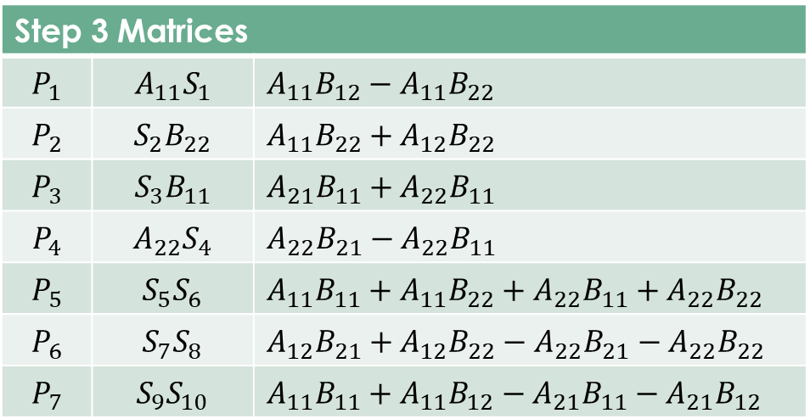
Step 3 Matrices
$$P_{1}$$ | $$A_{11}S_{1}$$ | $$A_{11}B_{12}−A_{11}B_{22}$$
$$P_{2}$$ | $$S_{2}B_{22}$$ | $$A_{11}B_{22}+A_{12}B_{22}$$
$$P_{3}$$ | $$S_{3}B_{11}$$ | $$A_{21}B_{11}+A_{22}B_{11}$$
$$P_{4}$$ | $A_{22}S_{4}$ | $$A_{22}B_{21}−A_{22}B_{11}$$
$$P_{5}$$ | $$S_{5}S_{6}$$ | $$A_{11}B_{11}+A_{11}B_{22}+A_{22}B_{11}+A_{22}B_{22}$$
$$P_{6}$$ | $$S_{7}S_{8}$$ | $$A_{12}B_{21}+A_{12}B_{22}−A_{22}B_{21}−A_{22}B_{22}$$
$$P_{7}$$ | $$S_{9}S_{10}$$ | $$A_{11}B_{11}+A_{11}B_{12}−A_{21}B_{11}−A_{21}B_{12}$$
$$\left[\begin{matrix}a_{11} & a_{12} & a_{13} & a_{14} \\ a_{21} & a_{22} & a_{23} & a_{24} \\ a_{31} & a_{32} & a_{33} & a_{34} \\ a_{41} & a_{42} & a_{43} & a_{44}\end{matrix}\right]$$
$A_{11}=\left[\begin{matrix}a_{11} & a_{12} \\ a_{21} & a_{22}\end{matrix}\right]$ $A_{12}=\left[\begin{matrix}a_{13} & a_{14} \\ a_{23} & a_{24}\end{matrix}\right]$
$A_{21}=\left[\begin{matrix}a_{31} & a_{32} \\ a_{41} & a_{42}\end{matrix}\right]$ $A_{22}=\left[\begin{matrix}a_{33} & a_{34} \\ a_{43} & a_{44}\end{matrix}\right]$

